Slide 1
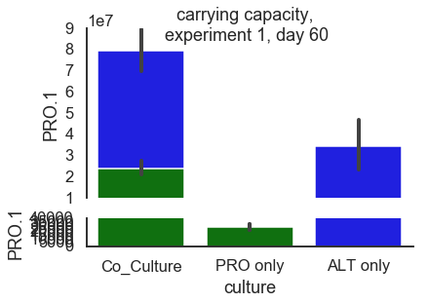
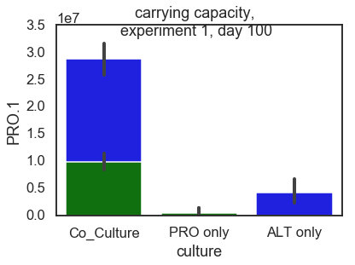
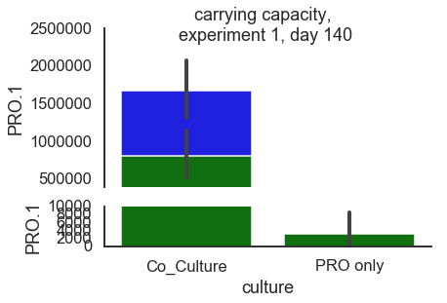
Total number of cells carrying capacity per day

Slide 2
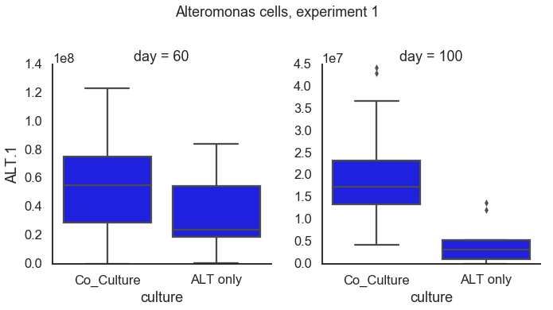
ALT co-culture vs axenic
day=60 : Ttest_indResult(statistic=2.7387394490570838, pvalue=0.007529210600903086)
day=100 : Ttest_indResult(statistic=6.2055728134674775, pvalue=1.9772383801176403e-08)

Slide 3
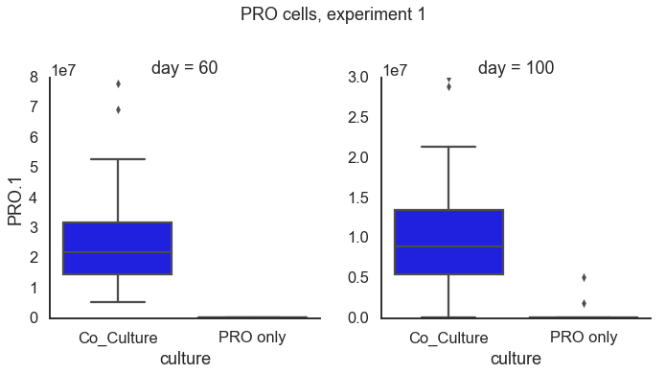
PRO co-culture vs axenic
day=60 Ttest_indResult(statistic=6.513651102735099, pvalue=4.737550066995795e-09)
day=100 Ttest_indResult(statistic=5.429712102261257, pvalue=5.150855380193557e-07)

Slide 4
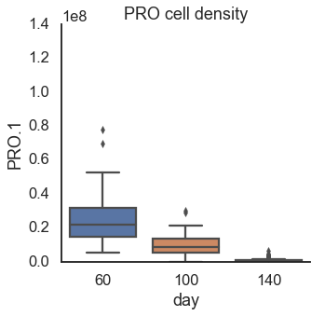
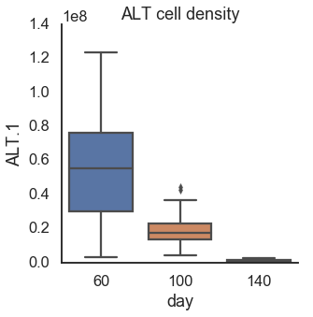

Slide 5
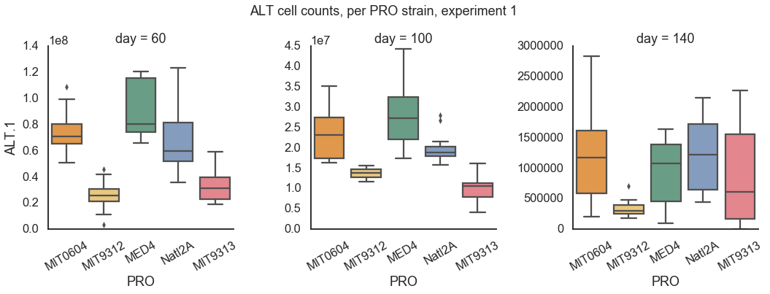
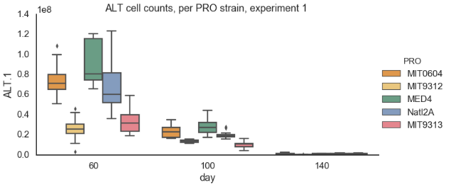
day=60
MIT9312-MED4 2.979887e-13
MIT9313-MED4 4.044107e-11
Natl2A-MED4 1.864648e-02
MIT9312-MIT0604 1.604945e-08
MIT9313-MIT0604 1.692750e-06
Natl2A-MIT9312 1.094969e-07
Natl2A-MIT9313 1.397843e-05
day=100
MIT9312-MED4 1.136526e-10
MIT9313-MED4 1.098858e-14
Natl2A-MED4 8.780070e-05
MIT9312-MIT0604 3.664213e-05
MIT9313-MIT0604 6.278300e-09
Natl2A-MIT9312 1.327496e-02
Natl2A-MIT9313 4.431006e-06
day=140
MIT9312-MIT0604 0.006170
Natl2A-MIT9312 0.004391

Slide 6
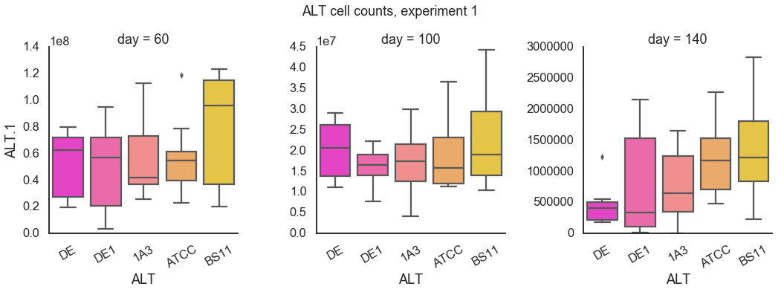
ALT cells as function of ALT strain, day=60
DE1-BS11 0.026893
ALT cells as function of ALT strain, day=140
DE-ATCC 0.015878
DE-BS11 0.001400
ALT cells as function of ALT strain, day=100

Slide 7
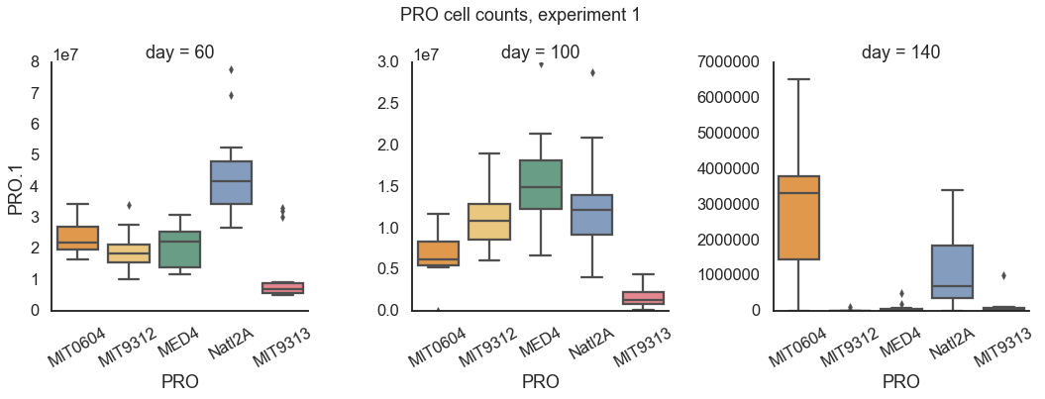
PRO cells as function of PRO strain, day=60
Natl2A-MED4 3.651113e-04
Natl2A-MIT0604 3.004083e-03
Natl2A-MIT9312 1.138943e-04
Natl2A-MIT9313 3.337528e-07
PRO cells as function of PRO strain, day=100
MIT0604-MED4 7.931135e-03
MIT9313-MED4 4.218253e-07
MIT9313-MIT9312 7.736621e-04
Natl2A-MIT9313 2.501980e-05
PRO cells as function of PRO strain, day=140
MIT0604-MED4 7.503304e-08
MIT9312-MIT0604 4.592467e-08
MIT9313-MIT0604 1.271490e-07
Natl2A-MIT0604 2.728215e-03

Slide 8
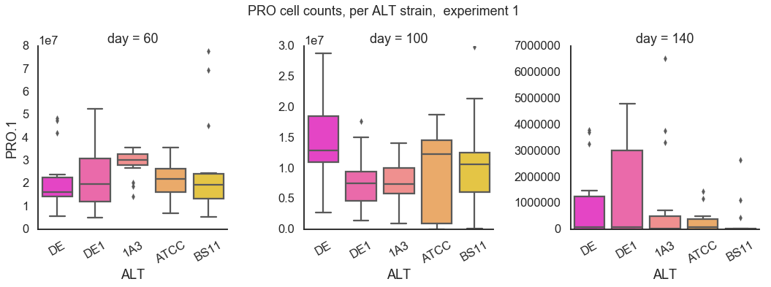
PRO cells as function of ALT strain, day=60
PRO cells as function of ALT strain, day=100
PRO cells as function of ALT strain, day=140

Slide 9
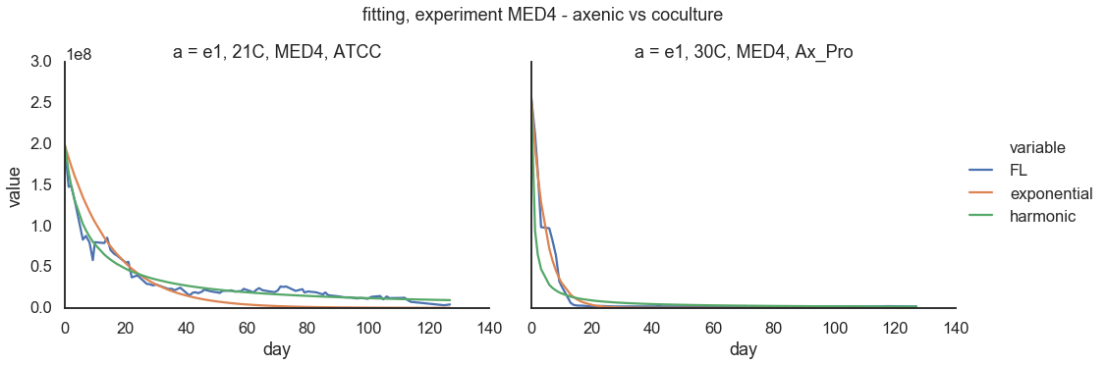
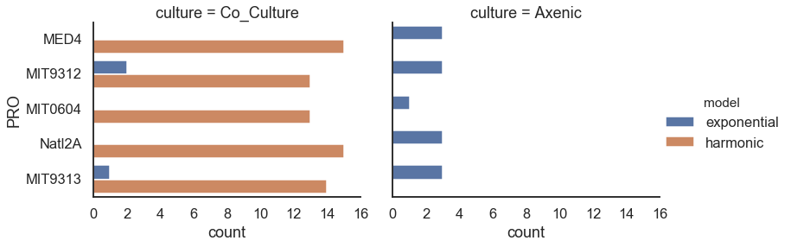
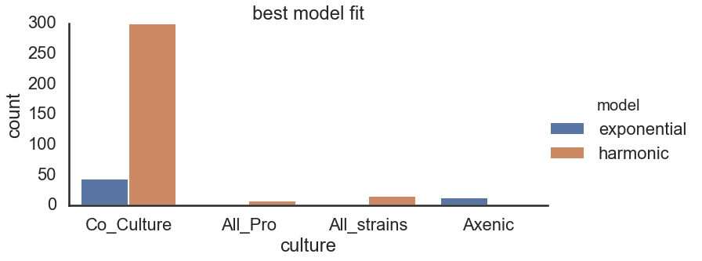
PRO cells
Exponential vs harmonic – cell numbers
Experiment 1

Slide 10
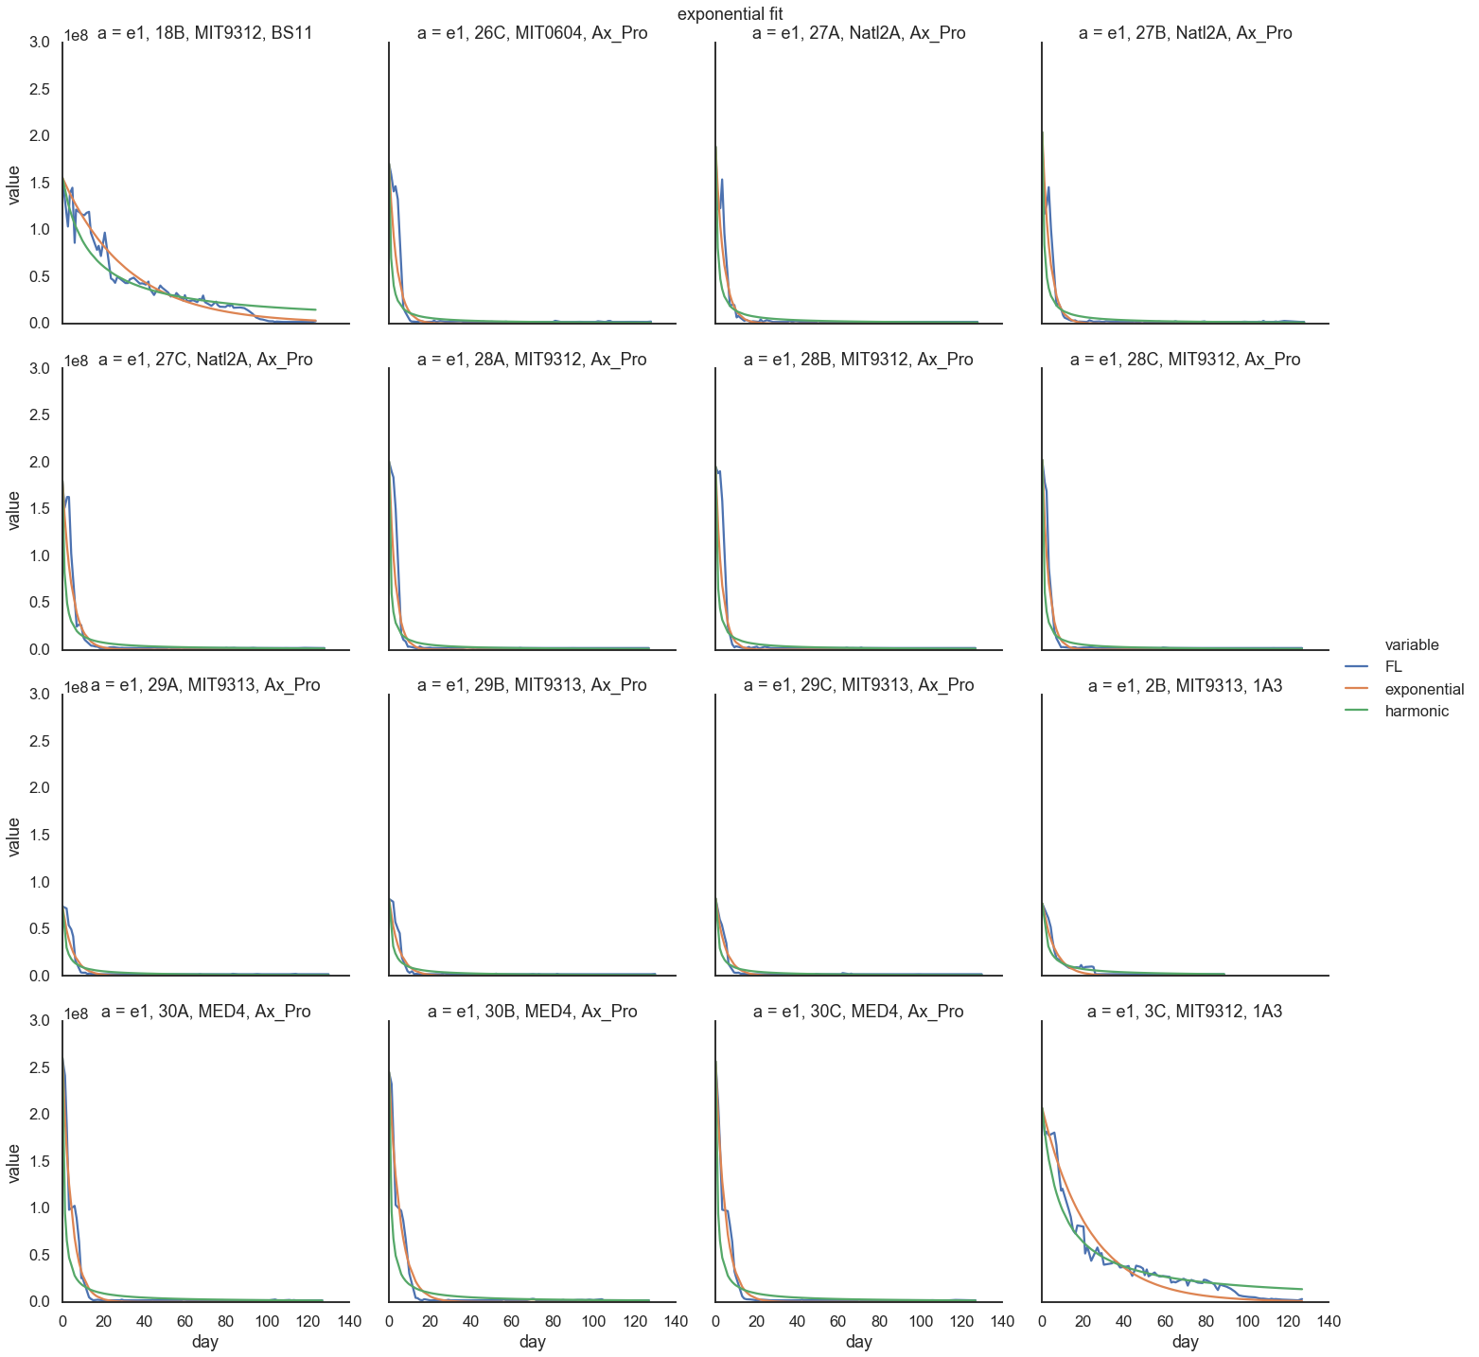
Exponential
fit

Slide 11
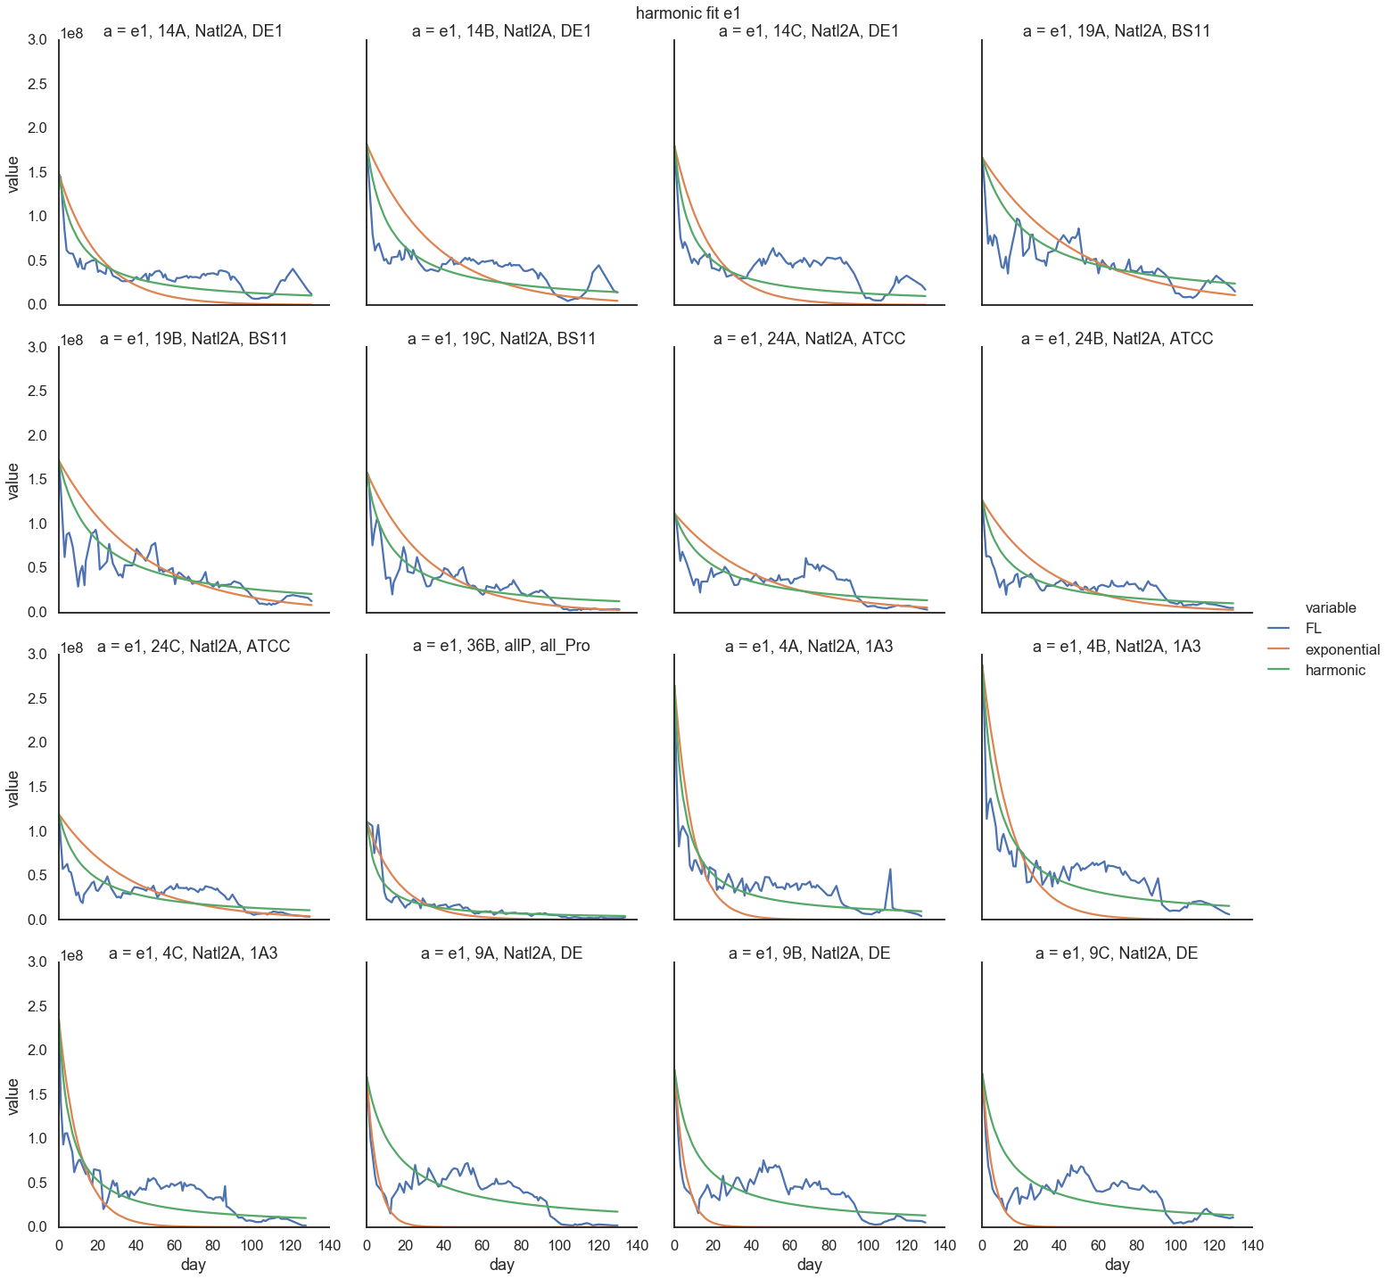
Harmonic fit

Slide 12
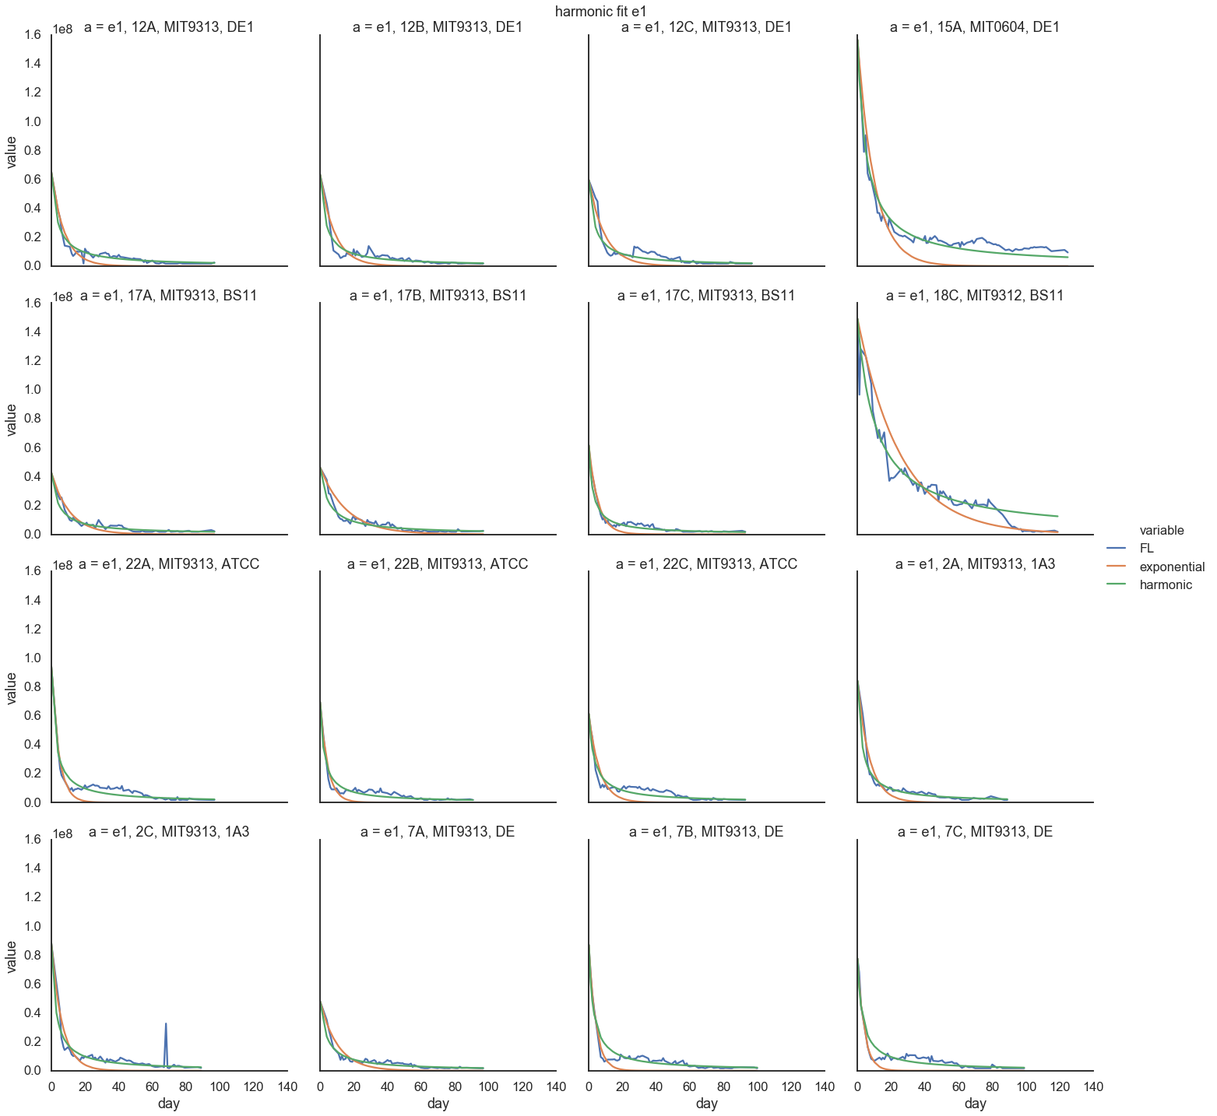
Harmonic fit

Slide 13
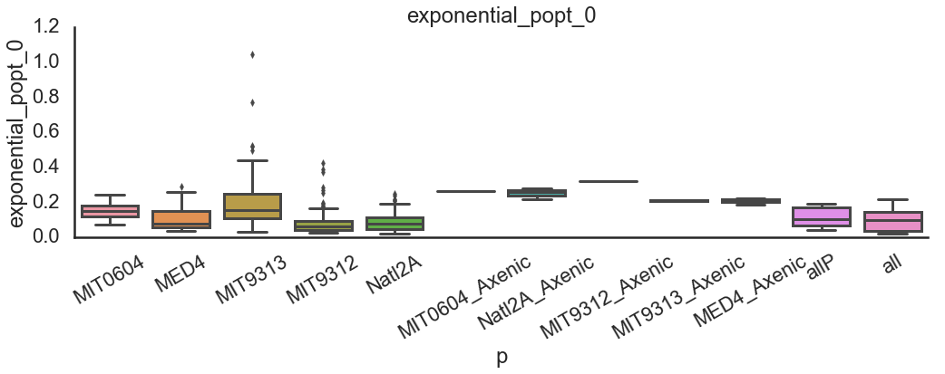
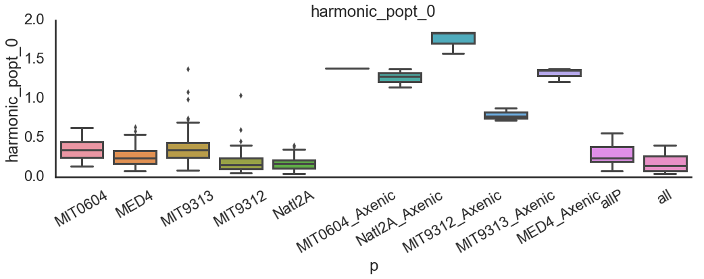

Slide 14
